Slide 1
New Medicare Card Project
New Medicare Card Project Open Door Forum
September 11, 2019

Slide 2
We Are Nearing the Finish Line!
Just 16 weeks away from the end of the transition!
Starting January 1, 2020, you must submit claims with the Medicare Beneficiary Identifier (MBI). CMS will reject claims submitted with the Health Insurance Claim Number (HICN), with limited exceptions.
Starting January 1, 2020, you must submit all eligibility transactions with the MBI. CMS will reject all eligibility transactions submitted with the HICN.
Are you ready?

Slide 3
New Medicare Card Mailing Complete
We’ve finished mailing new cards to people with Medicare across all U.S. states and territories.
Over 61 million beneficiaries got new cards in the mail since April 2018.
Includes people new to Medicare and existing beneficiaries.
All beneficiaries and providers should use MBIs Now!

Slide 4
Key Points to Reinforce with Beneficiaries
If someone with Medicare says they didn’t get a new card with a new number, they should:
Sign into MyMedicare.gov to see their Medicare number or print their official card. They must create an account if they don’t already have one.
Call 1-800-MEDICARE (1-800-633-4227) where we can verify their identity, check their address and help them get their new card. There might be something that needs to be corrected, like their mailing address.
Use their current card to get health care services (until December 31, 2019) but remember to bring your card the next time. (Providers: remember to get the MBI from the remittance advice and save it in your system to use the next time you submit a claim and give your patients the Get Your New Medicare Card flyer in English or Spanish.)

Slide 5
Key Points to Reinforce with Beneficiaries
Beneficiaries should:
Use their new Medicare card
Make sure to bring their new card with them when they get health care services – Very Important!!
Continue to protect their new Medicare number
CMS will never call beneficiaries uninvited for their Medicare number or other personal information. Beneficiaries who think their number is compromised should call 1-800-MEDICARE.
MBIs use numbers 0-9 and all uppercase letters except for S, L, O, I, B, and Z.
Don’t get confused between “0” and “O” when signing up for or logging into MyMedicare.gov.

Slide 6
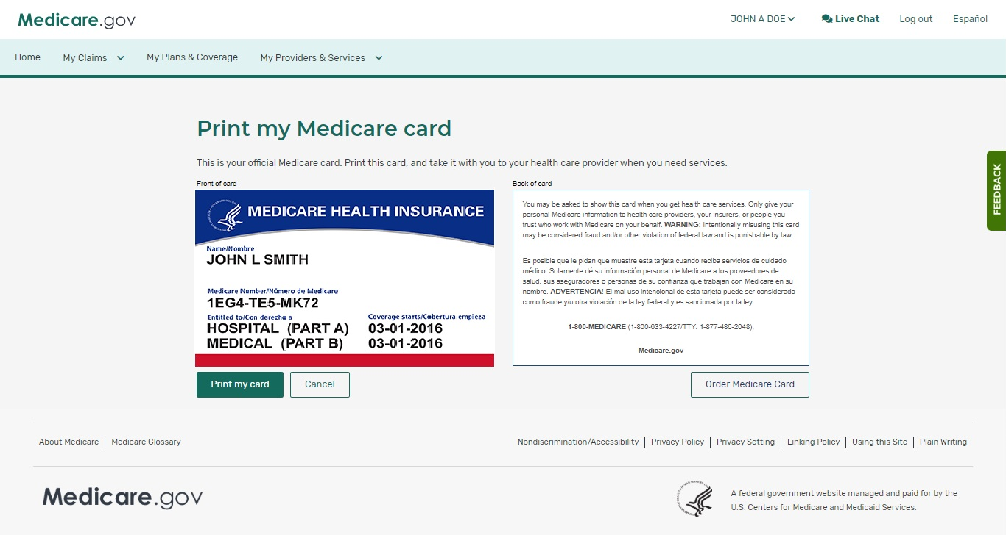
MyMedicare.gov - View or Print new Medicare card
Log into or sign up for MyMedicare.gov. Accounts are password-protected and secure.
Beneficiaries can view Medicare numbers/print a card.
This page is available to view on smaller devices like cell phones.
Notes:
MyMedicare.gov was recently refreshed

Slide 7
Transition Period (OCCURING NOW) April 1, 2018 – December 31, 2019
Transition Period (ALMOST OVER) April 1, 2018 – December 31, 2019

Slide 8
Transition Period Milestones
April 1, 2018- January 1, 2020
April 1, 2018
All systems & processes able to accept MBI. Mailing new Medicare cards to newly eligible people with Medicare. BEGIN TRANSITION PERIOD
May 2018
Continue mailing new Medicare cards with MBI to 60M beneficiaries
June 2018
Launch of provider
look-up tool
October 2018
Return MBI on remittance advice
MBI shared with downstream partners
Apr 16, 2019
Deadline for issuance of new Medicare cards
December 31, 2019
END OF TRANSITION PERIOD. Use the MBI on data exchanges

Slide 9
Using the New Medicare Number – During Transition
The transition period continues through December 31, 2019.
CMS is accepting, using for processing, and returning to stakeholders either the MBI or HICN, whichever is submitted on the claim, during the transition period.
We encourage all stakeholders who submit or receive transactions with the HICN to start submitting or exchanging the MBI now.
CMS is actively monitoring the use of HICNs and MBIs to ensure that everyone is ready to use MBIs only by January 1, 2020.
79% of Medicare fee-for-service claims now include the MBI!

Slide 10
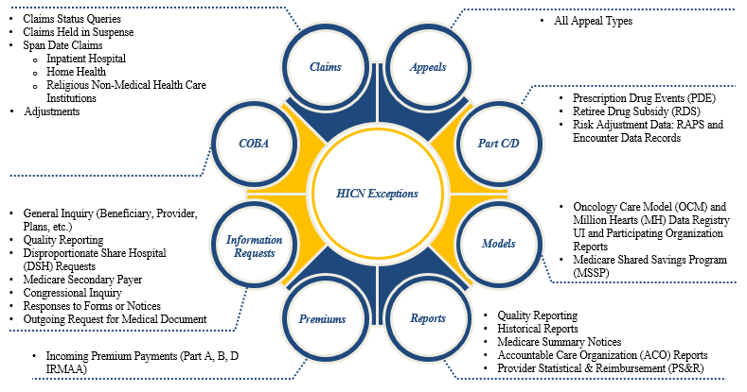
New Medicare Number HICN Exception Usage After the Transition Period
Beginning January 1, 2020, CMS will only accept the MBI for external data exchanges except for the following:
Note: CMS, Federal Partners and States will continue to use HICN for internal processing during and after the transition period.
Note: Even in cases where there are exceptions, CMS will accept the MBI anywhere we used to accept HICNs

Slide 11
Key Points for Providers
Providers Should Use the MBI Now!
Providers have 4 ways to get the new MBI:
Patient presents the card at time of service
Provider gets it through the a secure web portal with the MAC
Provider gets it through the remittance advice (through the end of the transition period)
Pharmacies get it through the E1 response (through the end of the transition period)
79% of Medicare fee-for-service claims now include the MBI, demonstrating that Medicare patients are successfully using their new cards in doctor’s offices and other health care facilities.
All beneficiaries and providers should use MBIs as soon as possible!

Slide 12
Using the New Medicare Number – Providers
Providers/Suppliers can use a MAC portal to look up any beneficiary’s MBI.
Providers must authenticate through their MAC portal with a valid user ID, password and NPI to look up a beneficiary’s MBI via the Provider Lookup Tool.
Providers must have the following beneficiary information to look-up MBIs:
Patient SSN, Last Name, First Name and Date of Birth
(Reminder - An individual’s HICN may not always be their own SSN if benefits are tied to a spouse. Thus, using the numerical part of a HICN will not always return a response in the MBI look-up tools. Instead, use the individual’s specific SSN.)
Additional information can be found at: https://www.cms.gov/Medicare/New-Medicare-Card/Providers/Providers-and-office-managers.html (providers can also reference the portal instructions sent in September 2017).

Slide 13
Using the New Medicare Number – Providers (2)
When a provider checks a beneficiary’s eligibility, the CMS HIPAA Eligibility Transaction System (HETS) returns a message on the response that says, "CMS mailed a Medicare card with a new Medicare Beneficiary Identifier (MBI) to this beneficiary. Medicare providers, please get the new MBI from your patient and save it in your system(s)."
Through the end of the transition period, when a provider submits a valid and active HICN on Medicare fee-for-service claims, CMS will return both the HICN and the MBI on the remittance advice.
Providers have resources when they talk to people with Medicare about the new Medicare cards: https://www.cms.gov/Medicare/New-Medicare-Card/Outreach-and-Education/Products-to-share-with-beneficiaries.html

Slide 14
Using the New Medicare Number – Providers (3)
To encourage providers to use the MBI now, CMS is periodically announcing the current national rate of FFS claims submitted with MBIs through Medicare Learning Network (MLN) Connects.
Providers and health care professionals can subscribe to MLN Connects on CMS.gov to get the weekly email newsletter.
January 16, 2019
For the week ending 1/11/19, 58% of FFS claims were submitted with the MBI.
February 7, 2019
For the week ending 1/25/19, 62% of FFS claims were submitted with the MBI.
March 28, 2019
For the week ending 3/22/19, 68% of FFS claims were submitted with the MBI.
June 20, 2019
For the week ending 6/14/19, 75% of FFS claims were submitted with the MBI.
July 11, 2019
For the week ending 7/5/19, 76% of FFS claims were submitted with the MBI.
August 15, 2019
For the week ending 8/2/19, 77% of FFS claims were submitted with the MBI.
*Since the last MLN Connects announcement, the FFS claims submission rate with the MBI has increased to 79% for the week ending 8/23/19.

Slide 15
Using the New Medicare Number – Plans / Pharmacies
Plans
All Medicare Advantage and Prescription Drug Plans received a HICN to MBI crosswalk file prior to the start of the transition period (April 1, 2018).
The MARx User Interface (UI) is now showing both the HICN and the MBI during the transition, but only the MBI when the transition’s over.
Medicare Advantage and Prescription Drug (Part D) Plans may submit either the Health Insurance Claim Number (HICN) or the Medicare Beneficiary Identifier (MBI) both during and after the transition period for Prescription Drug Event (PDE) and Risk Adjustment Records (i.e., RAPS and Encounter Data).
CMS has provided information regarding the systems changes via the Health Plan Management System (HPMS) memos that have been released for the systems impacted.
For beneficiaries enrolled in Medicare Advantage Plans, they should use their new card to enroll in a Medicare Advantage or Prescription Drug Plan.
All Medicare beneficiaries who are enrolled in a Medicare Advantage and/or a Prescription Drug Plan will still receive an insurance card from their Plan that they must continue to use when obtaining services while enrolled in the Plan.
E1 Transactions for Pharmacies
Both the Part D and A/B E1 transactions will return the MBI.
Pharmacies may submit the HICN or MBI now and after the transition.

Slide 16
Using the New Medicare Number – Other Stakeholders
Accountable Care Organizations (ACOs)
ACOs get MBI information for their assigned Medicare beneficiary populations.
CMS includes Both HICNs and MBIs in the Claims and Claims Line Feed Files (CCLFs) until December 2019.
Crossover Claims Processing
During the transition period, CMS is processing and transmitting Medicare crossover claims using either (HICN) or (MBI).
After the transition period, CMS will continue to transmit Medicare crossover claims with either the HICN or MBI based upon what identifier was included on the incoming claim. This will be a common occurrence for adjustment claims where the original claim contained a HICN.
Medicaid Agencies – Dual Eligible Medicare and Medicaid beneficiaries
State Medicaid Agencies get both HICNs and MBIs in their system exchanges with CMS.
State Third Party Buy-In Dual Eligible beneficiaries will continue to use HICN now and post transition.

Slide 17
Using the New Medicare Number – Other Stakeholders (2)
Private Payers
For non-Medicare business, private payers won’t have to use the MBI.
For Medicare, we’ll continue to use supplemental insurer’s unique numbers to identify customers, but after the transition period, supplemental insurers must use the MBI for any Medicare transactions where they would have used the HICN.
Third Party Group Payers
Third Party Group (TPG) Payers systems accept either the MBI or the HICN throughout the transition period.
However, after the transition period—as of January 1, 2020, TPG Payers must use the MBI for any Medicare transactions where they would have used the HICN.

Slide 18
Railroad Retirement Board (RRB) Beneficiaries
RRB mailed cards to their beneficiaries with the RRB logo, but you can’t tell from looking at the MBI if beneficiaries are eligible for Medicare because they’re railroad retirees.
We return a message on the HETS eligibility transaction response to alert the provider it’s an RRB patient. The message says, "Railroad Retirement Medicare Beneficiary.”
Medicare Providers should have already programmed their systems to identify RRB beneficiaries so they know to send those claims to the Specialty Medicare Administrative Contractor (SMAC).

Slide 19
Final Thoughts
Thank you for participating in this discussion today. There’s more information about the New Medicare Card on our websites:
For stakeholder/operational information go to: https://www.cms.gov/newcard
For beneficiary focused information go to: https://www.medicare.gov/forms-help-resources/your-medicare-card
For resources to use when you talk to people with Medicare about the new Medicare cards: https://www.cms.gov/Medicare/New-Medicare-Card/Partners-and-Employers/Partners-and-employers.html
Please submit any additional comments or questions to the New Medicare Card team mailbox: NewMedicareCardSSNRemoval@cms.hhs.gov
Notes:
CMS is actively accepting and processing claims using the MBI.
All Beneficiaries and Providers should use MBIs as soon as possible!
Remember the transition ends December 31, 2019
Providers Should be Using the MBI Now!

